Slide 1
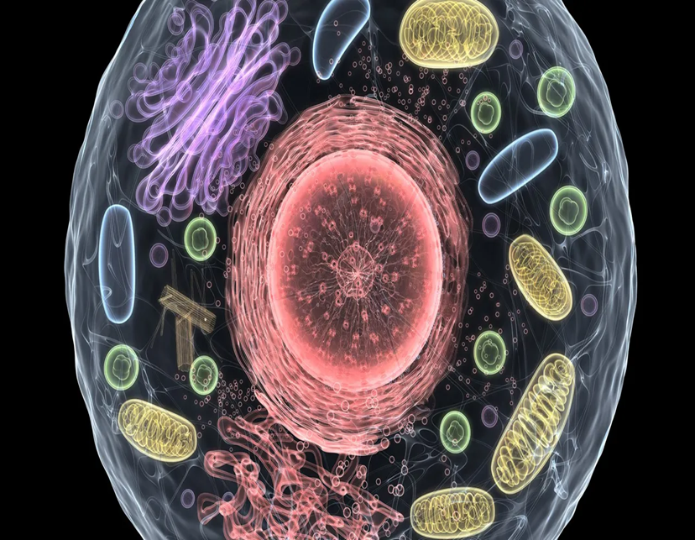
Introduction to Cytology
Presented by Dr. Aouati Amel

Slide 2
Agenda
Introduction to Cytology What is cytology ?
History of Cytology Cell Structure Overview Types of Cells Studied General characteristics of Eukaryotic human cells
Cellular level

Slide 3
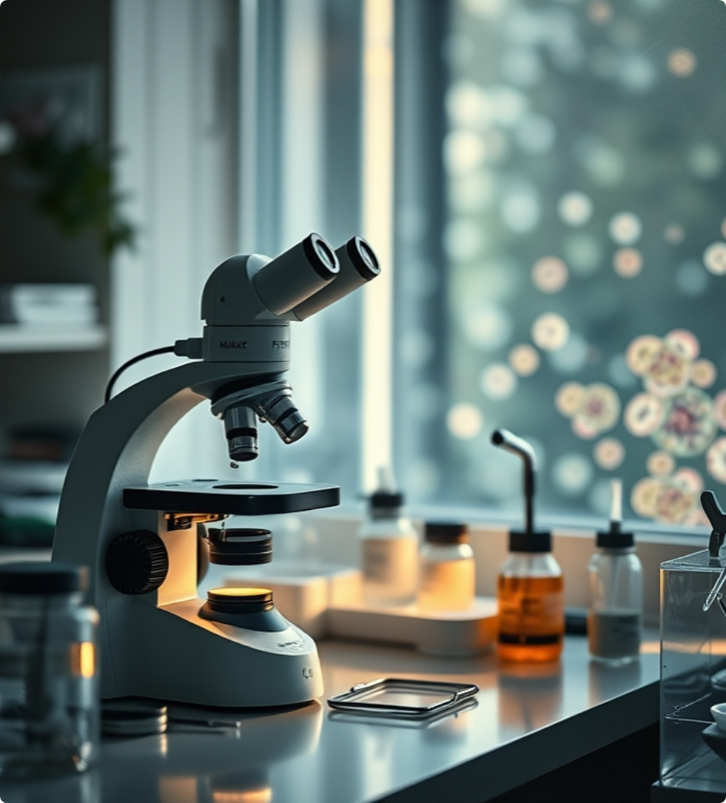
What is Cytology?
Definition of Cytology
Cytology is the branch of biology that studies cells, including their structure and function, to understand their role in living organisms.
Scope of Cytology
It covers the examination of cell morphology, cell cycle, cell activities, and interactions to diagnose diseases and conduct research.
Importance in Medicine
Cytology is crucial for detecting cancer, infections, and genetic disorders through microscopic analysis of cells obtained from tissues or fluids.

Slide 4
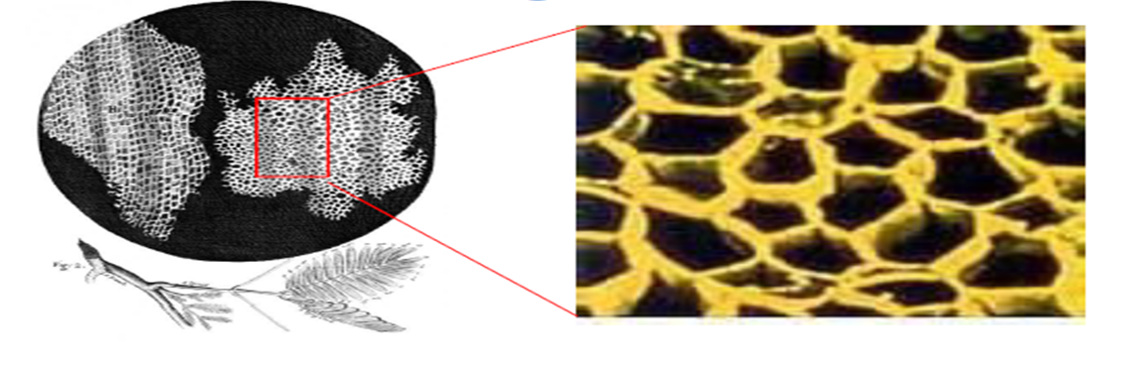
History of Cytology
1665
1838
1879
1920s
2000s
Cell Discovery
Cell Theory Formulated
Staining Techniques Developed
Cytology as a Diagnostic Tool
Molecular Cytology Advances
Robert Hooke first described cells by observing cork under a microscope, coining the term 'cell'.
Matthias Schleiden and Theodor Schwann proposed that all living organisms are composed of cells.
Paul Ehrlich developed staining methods allowing better visualization of cells under the microscope.
Integration of molecular techniques enhanced cell analysis and disease diagnosis.

Slide 5
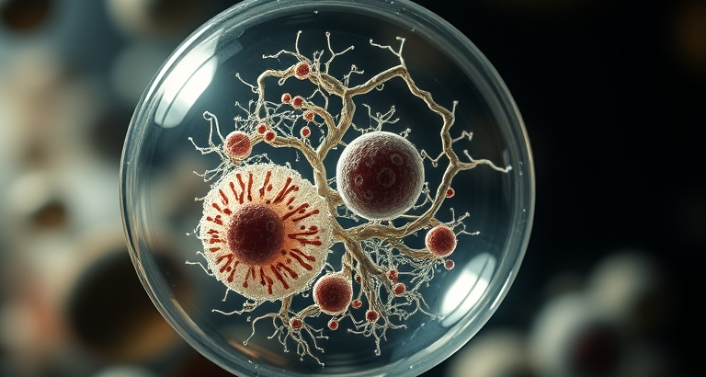
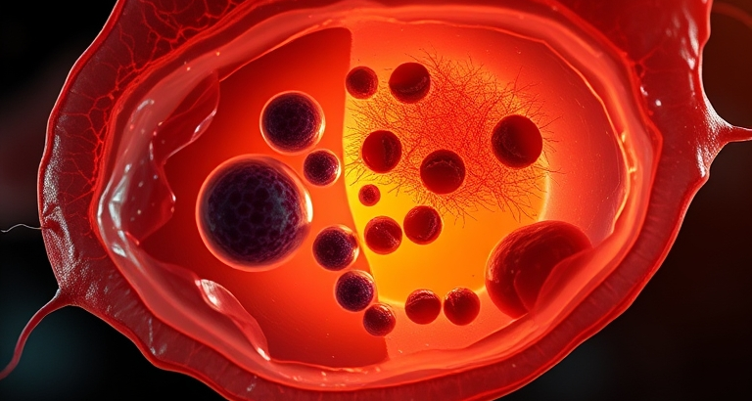
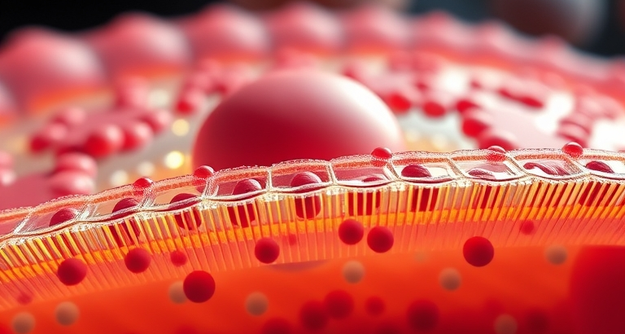
Cell Structure Overview
Nucleus - The Control Center
Cytoplasm - Cellular Matrix
Cell Membrane - Protective Barrier

Slide 6
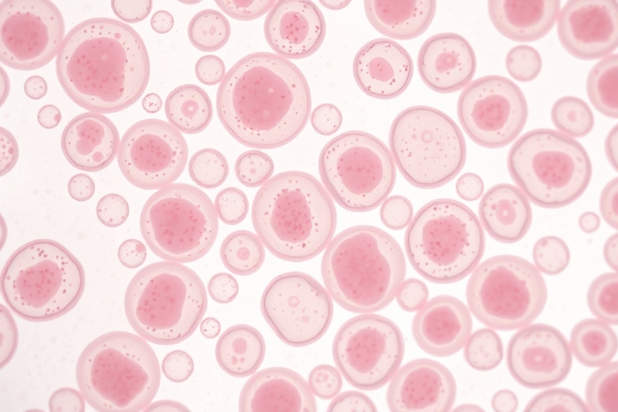
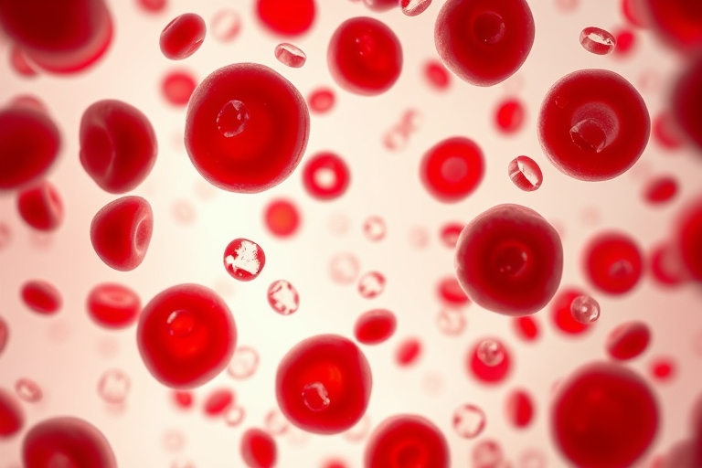
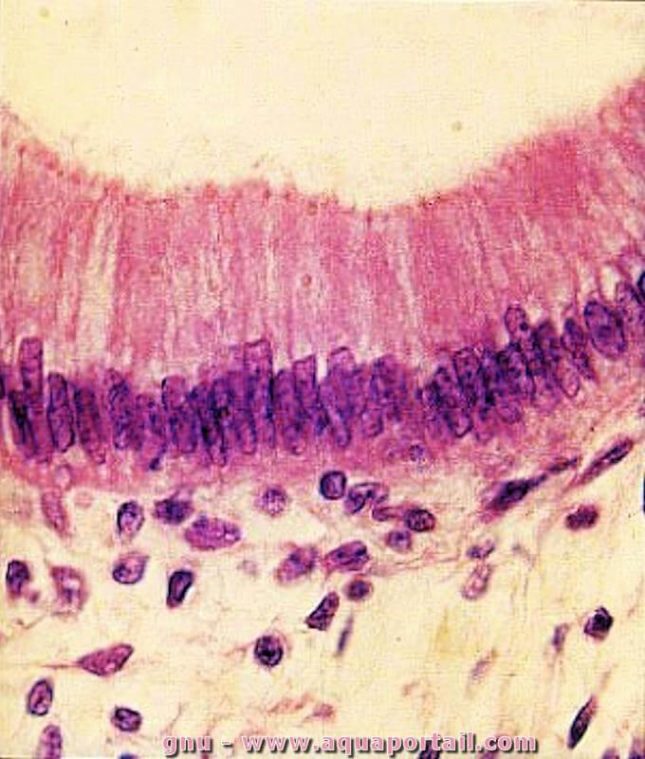
Types of Cells Studied in Cytology
Epithelial Cells
Blood Cells
Intestinal Cells

Slide 7
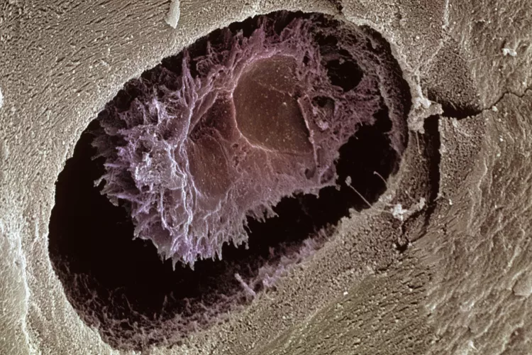
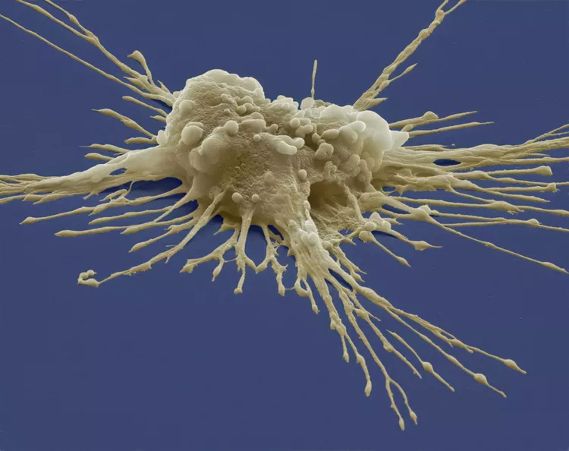
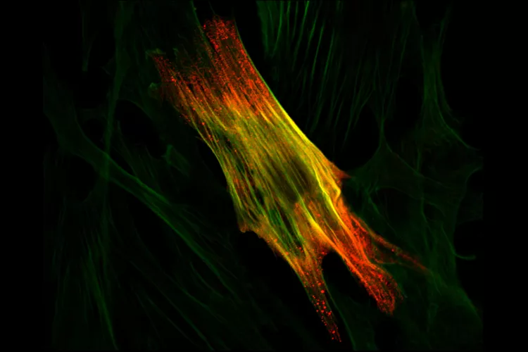
Stem Cell
Bone Cell
Muscle Cell

Slide 8
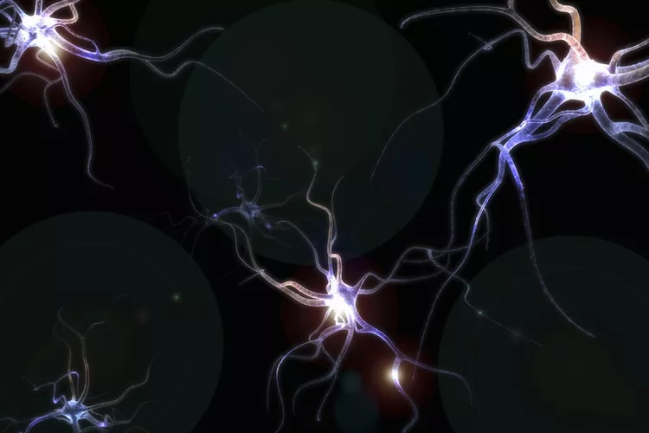
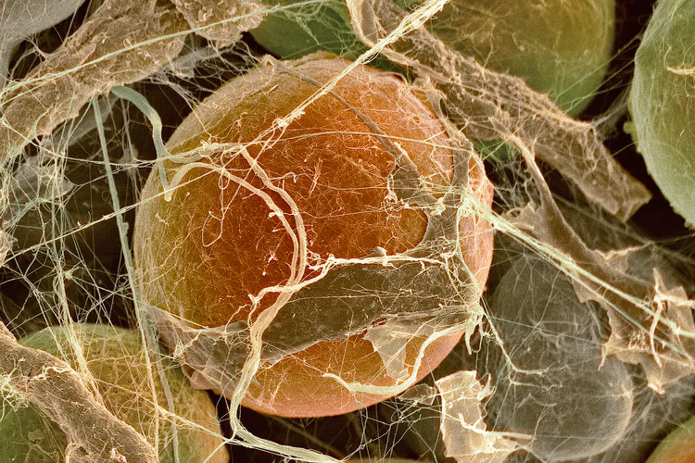
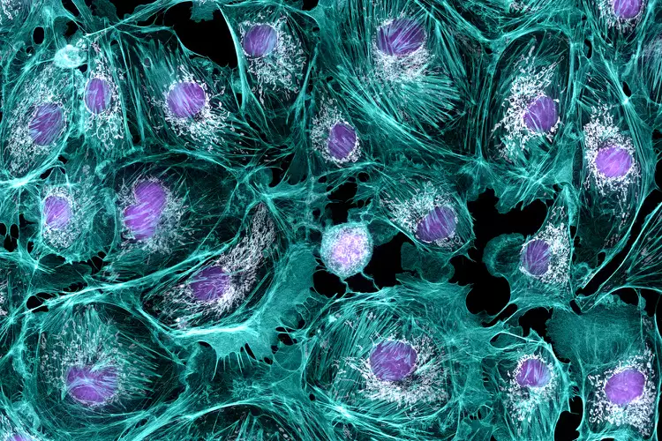
Fat Cell
Nerve Cell
Endothelial Cell

Slide 9
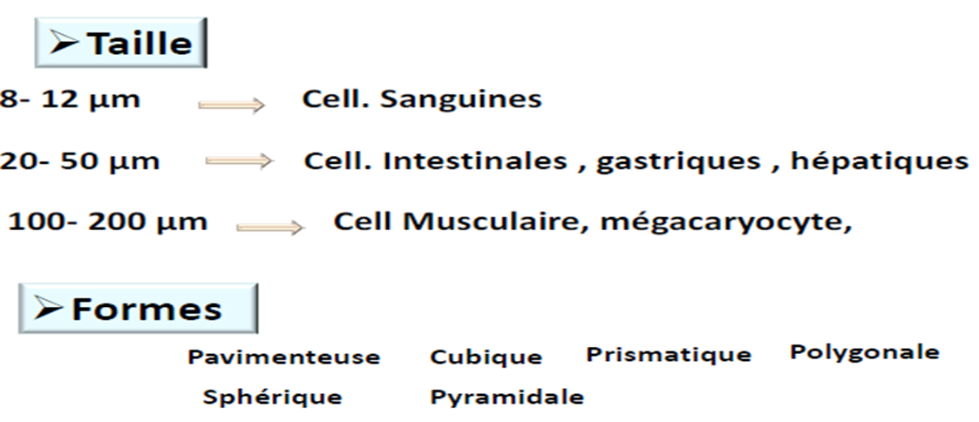
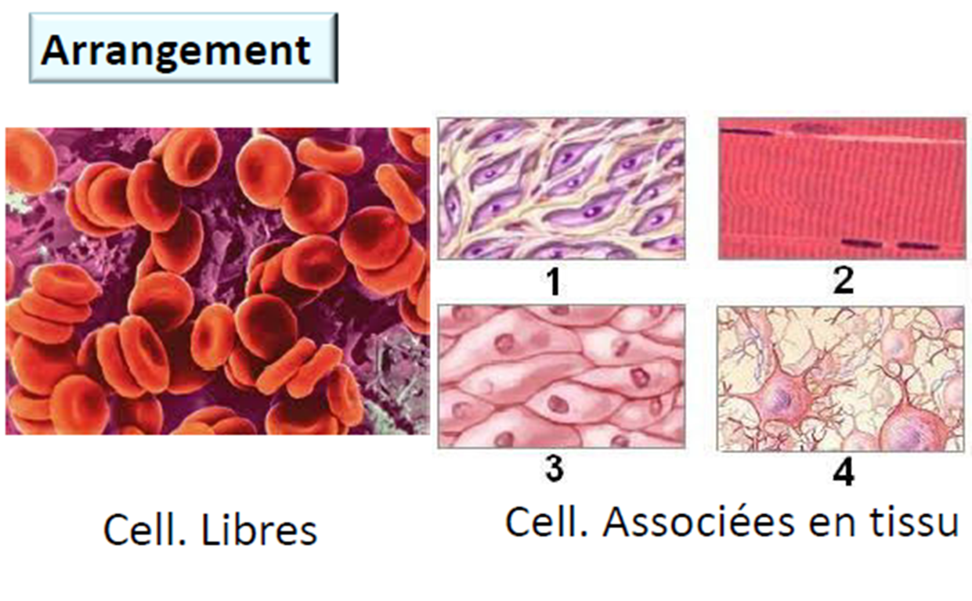
General characteristics of Eukaryotic human cells

Slide 10
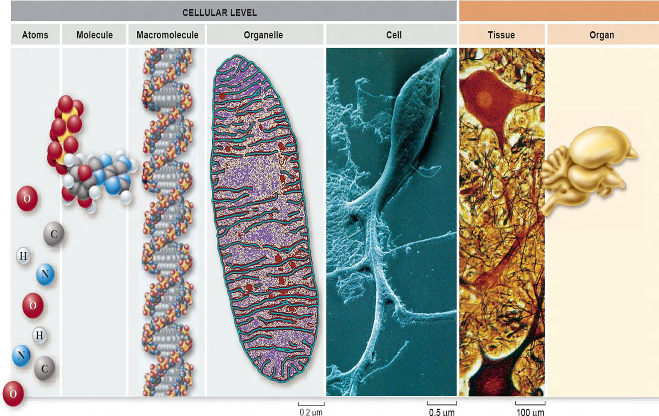

Slide 11
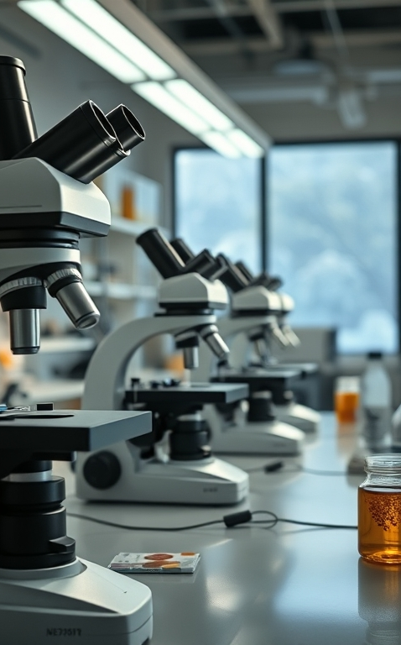
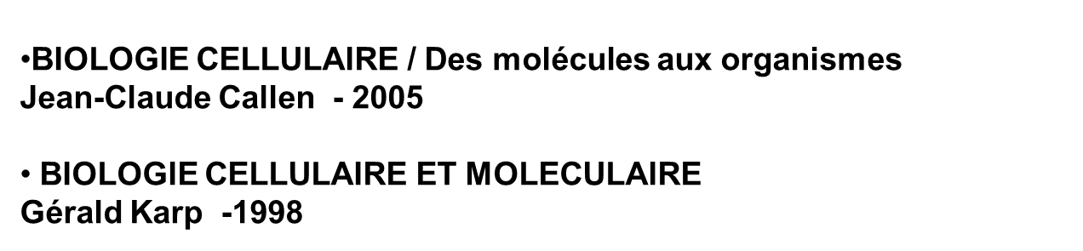
Science books used

